Slide 1
Identify opportunities to generate more premium customers
Analysis of existing premium and regular customer profiles
Presentation by: Carina Höbart

Slide 2
Collection and preparation of data
Step 01
Step 02
Step 03
Step 04
Collect data
Anonymize data
Translate data
Cleaning data
Anonymizing and / or eliminate/replace any sensitive or unique identifier from data
Translate and replace german values
Company database,
get sample of 150 of each (regular / premium),
Simplify data

Slide 3
Characteristics of customer profiles
Gender
Male or female
Age
Calculated by given date of birth
Economic sector
Chosen by customer from given options
Income bucket
Calculated based incoming monthly transactions
Premium
Yes or no. Customer has premium subscription or not

Slide 4
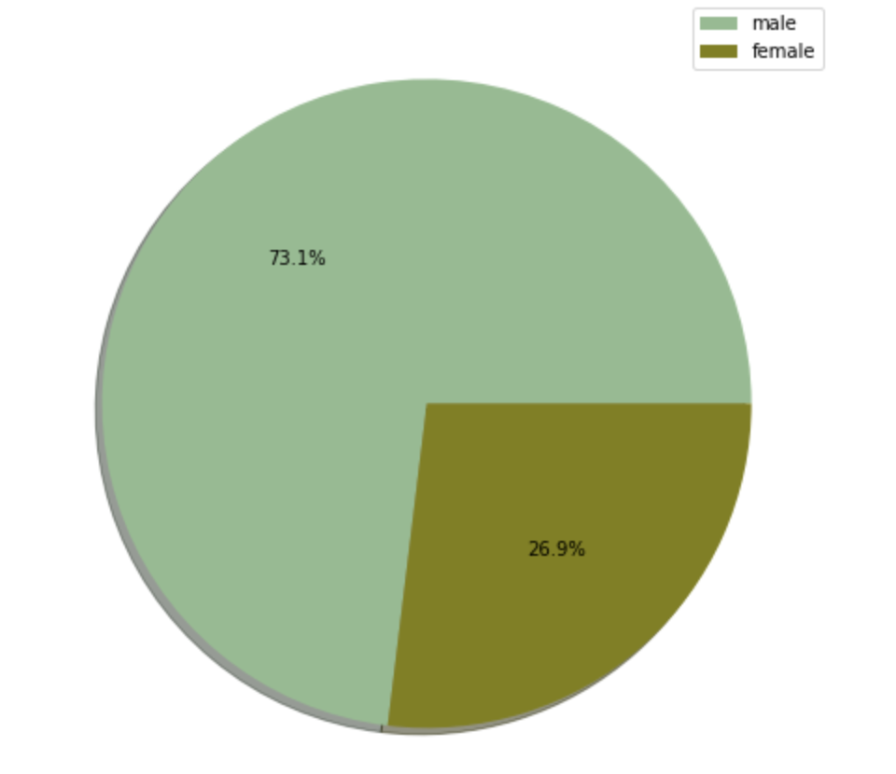
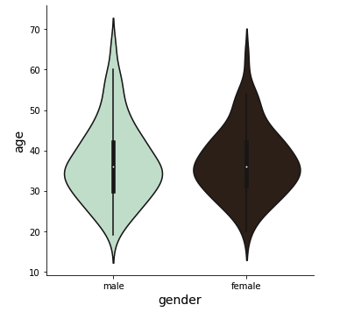
Getting to know the dataset
Gender distribution of dataset
Age distribution of dataset

Slide 5
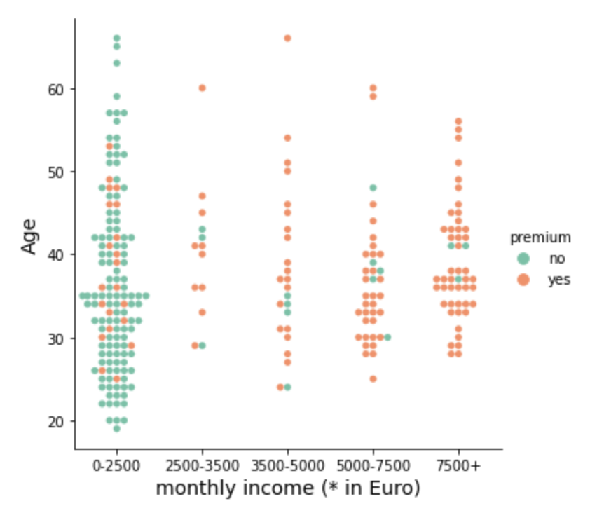
Premium subscription
Relationship of age, income and premium subscription

Slide 6
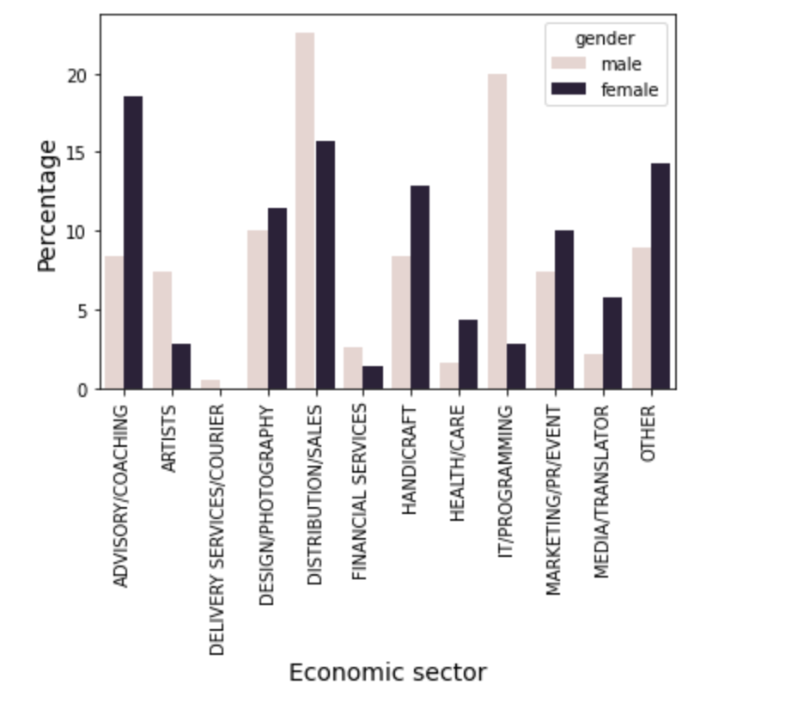
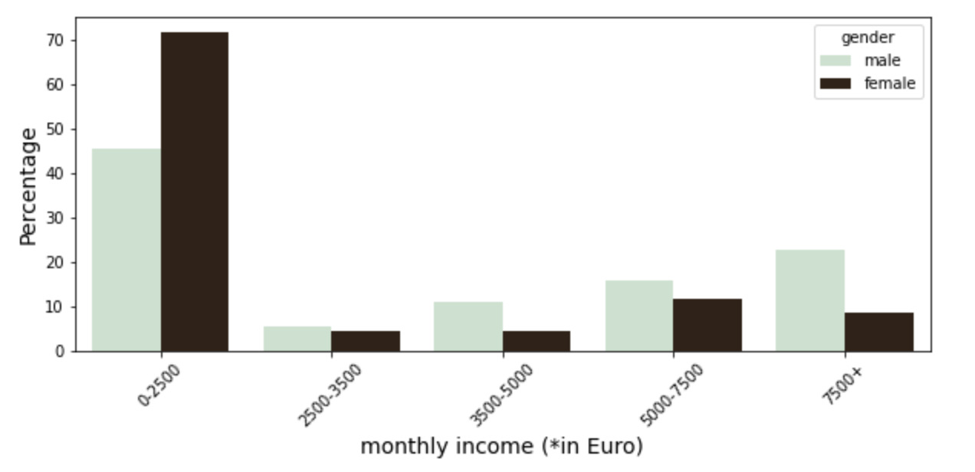
Economic sector & monthly income by gender (1 / 2)

Slide 7
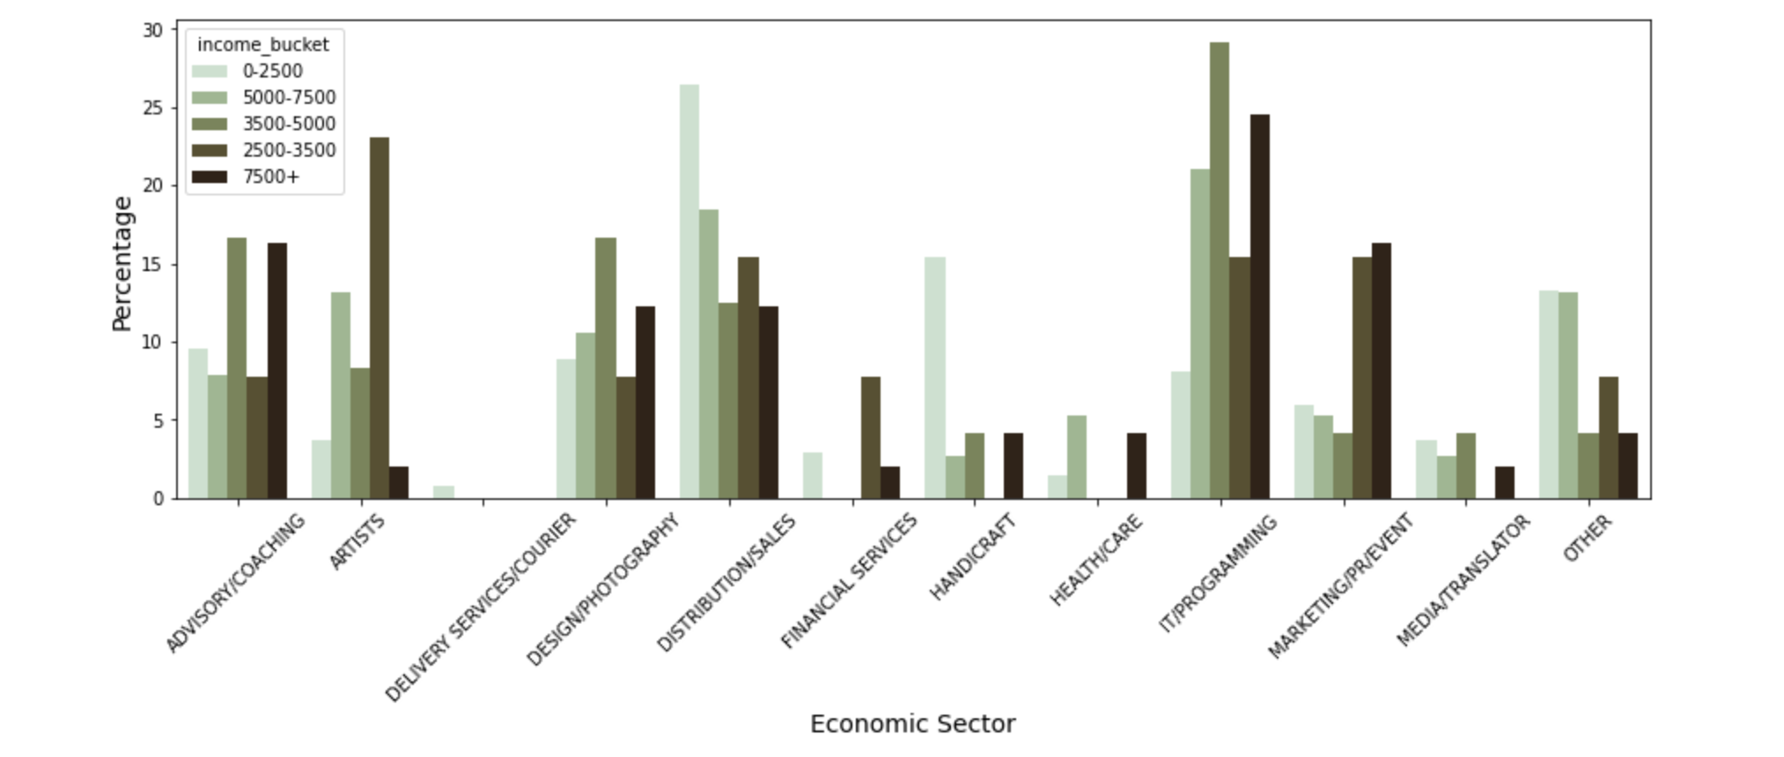
Economic sector & monthly income (2 / 2)
Top 3 highest earning economic sectors
IT / Programming
Marketing /PR / Event
Advisory / Coaching

Slide 8
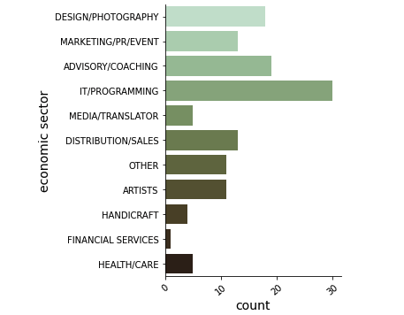

Profile on average premium customer
Characteristic of avg. premium customer
Gender: male
Sector: IT / Programming
Avg. Age: 36
Avg. Income: 5000-7500€
*Average programmer according to google ;)

Slide 9
Learnings & next steps
Learnings
we reach the target audience we planned to reach
monthly income has an impact on choice of subscription
Next step
Fit analysis to whole customer data

Slide 10
THANK YOU FOR YOUR ATTENTION
ANY QUESTIONS?
Presentation by: Carina Höbart

